Slide 1
V P N
Virtual private network

Slide 2
What is VPN?
A virtual private network (VPN) is a mechanism for creating a secure connection between a computing device and a computer network, or between two networks, using an insecure communication medium such as the public Internet.
A VPN can extend access to a private network (one that disallows or restricts public access) to users who do not have direct access to it, such as an office network allowing secure access from off-site over the Internet.The benefits of a VPN include security, reduced costs for dedicated communication lines, and greater flexibility for remote workers.
A VPN is created by establishing a virtual point-to-point connection through the use of tunneling protocols over existing networks. A VPN available from the public Internet can provide some of the benefits of a private wide area network (WAN). From a user perspective, the resources available within the private network can be accessed remotely.

Slide 3
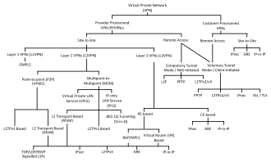
Types Of VPN
Virtual private networks may be classified into several categories:
Remote access
A host-to-network configuration is analogous to connecting a computer to a local area network. This type provides access to an enterprise network, such as an intranet. This may be employed for remote workers, or to enable a mobile worker to access necessary tools without exposing them to the public Internet.

Slide 4
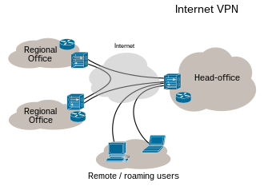
.
Site-to-siteA
site-to-site configuration connects two networks. This configuration expands a network across geographically disparate offices or connects a group of offices to a data center installation. The interconnecting link may run over a dissimilar intermediate network, such as two IPv6 networks connected over an IPv4 network.
Extranet-based site-to-site
In the context of site-to-site configurations, the terms intranet and extranet are used to describe two different use cases.An intranet site-to-site VPN describes a configuration where the sites connected by the VPN belong to the same organization, whereas an extranet site-to-site VPN joins sites belonging to multiple organizations.Typically, individuals interact with remote access VPNs, whereas businesses tend to make use of site-to-site connections for business-to-business, cloud computing, and branch office scenarios. However, these technologies are not mutually exclusive and, in a significantly complex business network, may be combined to enable remote access to resources located at any given site, such as an ordering system that resides in a data center.

Slide 5
VPN systems also may be classified by:VPN systems also may be classified by:
the tunneling protocol used to tunnel the traffic.
the tunnel's termination point location, e.g., on the customer edge or network-provider edge.
the type of topology of connections, such as site-to-site or network-to-network.
the levels of security provided.
the OSI layer they present to the connecting network, such as Layer 2 circuits or Layer 3 network connectivity.
the number of simultaneous connections.

Slide 6
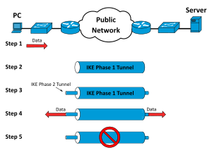
Security mechanisms
VPNs cannot make online connections completely anonymous, but they can increase privacy and security by encrypting all communication between remote locations over the open Internet. To prevent disclosure of private information or data sniffing, VPNs typically allow only authenticated remote access using^{[clarification needed]} tunneling protocols and secure encryption techniques.
The VPN security model provides:
confidentiality such that even if the network traffic is sniffed at the packet level (see network sniffer or deep packet inspection), an attacker would see only encrypted data, not the raw data
sender authentication to prevent unauthorized users from accessing the VPN
message integrity to detect and reject any instances of tampering with transmitted messages

Slide 7
Routing
Tunneling protocols can operate in a point-to-point network topology however, this would theoretically not be considered a VPN because a VPN by definition is expected to support arbitrary and changing sets of network nodes. But since most router implementations support a virtual, software-defined tunnel interface, customer-provisioned VPNs often are simply^{[ambiguous]} defined tunnels running conventional routing protocols.

Slide 8
Provider-provisioned VPN building blocks
Depending on whether a provider-provisioned VPN (PPVPN) operates in Layer 2 (L2) or Layer 3 (L3), the building blocks described below may be L2 only, L3 only, or a combination of both. Multiprotocol Label Switching (MPLS) functionality blurs the L2–L3 identity.
RFC 4026 generalized the following terms to cover L2 MPLS VPNs and L3 (BGP) VPNs, but they were introduced in RFC 2547.

Slide 9
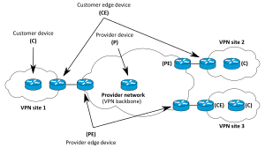
Site-to-site VPN Terminology

Slide 10
.
Customer (C) devices A device that is within a customer's network and not directly connected to the service provider's network. C devices are not aware of the VPN.
Customer edge device (CE) A device at the edge of the customer's network which provides access to the PPVPN. Sometimes it is just a demarcation point between provider and customer responsibility. Other providers allow customers to configure it.
Provider edge device (PE) A device, or set of devices, at the edge of the provider network that connects to customer networks through CE devices and presents the provider's view of the customer site. PEs are aware of the VPNs that connect through them, and maintain VPN state.
Provider device (P) A device that operates inside the provider's core network and does not directly interface to any customer endpoint. It might, for example, provide routing for many provider-operated tunnels that belong to different customers' PPVPNs. While the P device is a key part of implementing PPVPNs, it is not itself VPN-aware and does not maintain VPN state. Its principal role is allowing the service provider to scale its PPVPN offerings, for example, by acting as an aggregation point for multiple PEs. P-to-P connections, in such a role, often are high-capacity optical links between major locations of providers.

Slide 11
VPNs in mobile environments
Mobile virtual private networks are used in settings where an endpoint of the VPN is not fixed to a single IP address, but instead roams across various networks such as data networks from cellular carriers or between multiple Wi-Fi access points without dropping the secure VPN session or losing application sessions.^{[37]} Mobile VPNs are widely used in public safety where they give law-enforcement officers access to applications such as computer-assisted dispatch and criminal databases,^{[38]} and in other organizations with similar requirements such as field service management and healthcare.

Slide 12
Networking limitations
A limitation of traditional VPNs is that they are point-to-point connections and do not tend to support broadcast domains; therefore, communication, software, and networking, which are based on layer 2 and broadcast packets, such as NetBIOS used in Windows networking, may not be fully supported as on a local area network. Variants on VPN such as Virtual Private LAN Service (VPLS) and layer 2 tunneling protocols are designed to overcome this limitation.

Slide 13
THANK YOU
NAME- KRISH KR. SINGH
CONTACT-000236666
E-MAIL- krish10kks@gmail.com
FOR ANY QUARRY YOU CAN CONTACT US.

